Slide 1
Medical Image Generation and Analysis using Bayesian Generative Models
Razvan Marinescu
University of California, Santa Cruz

Slide 2
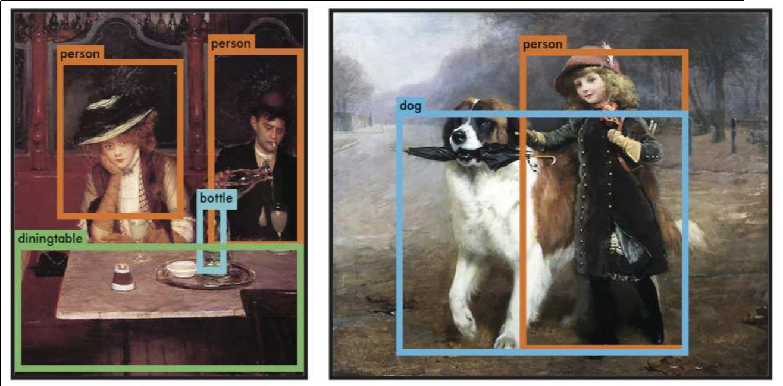
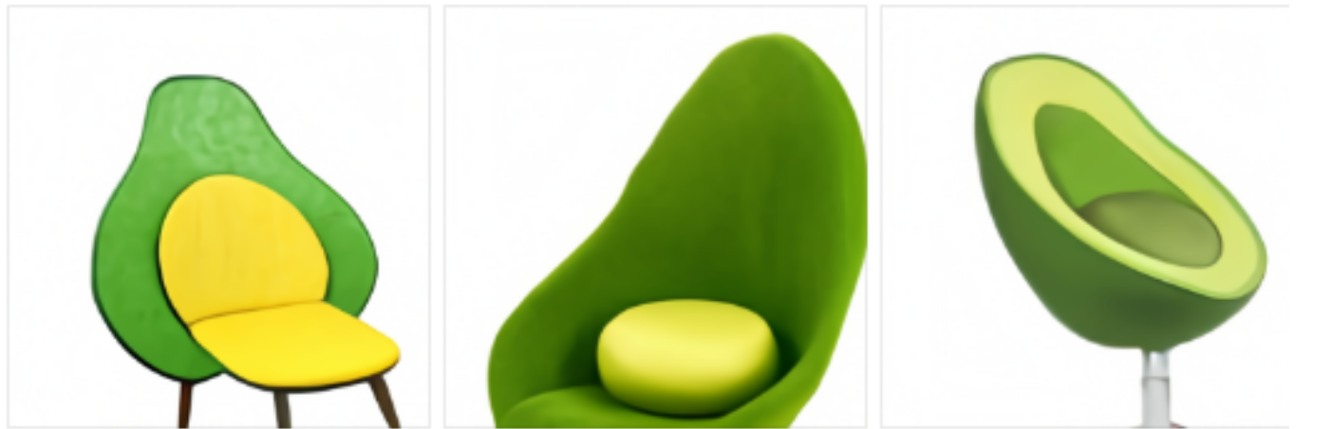
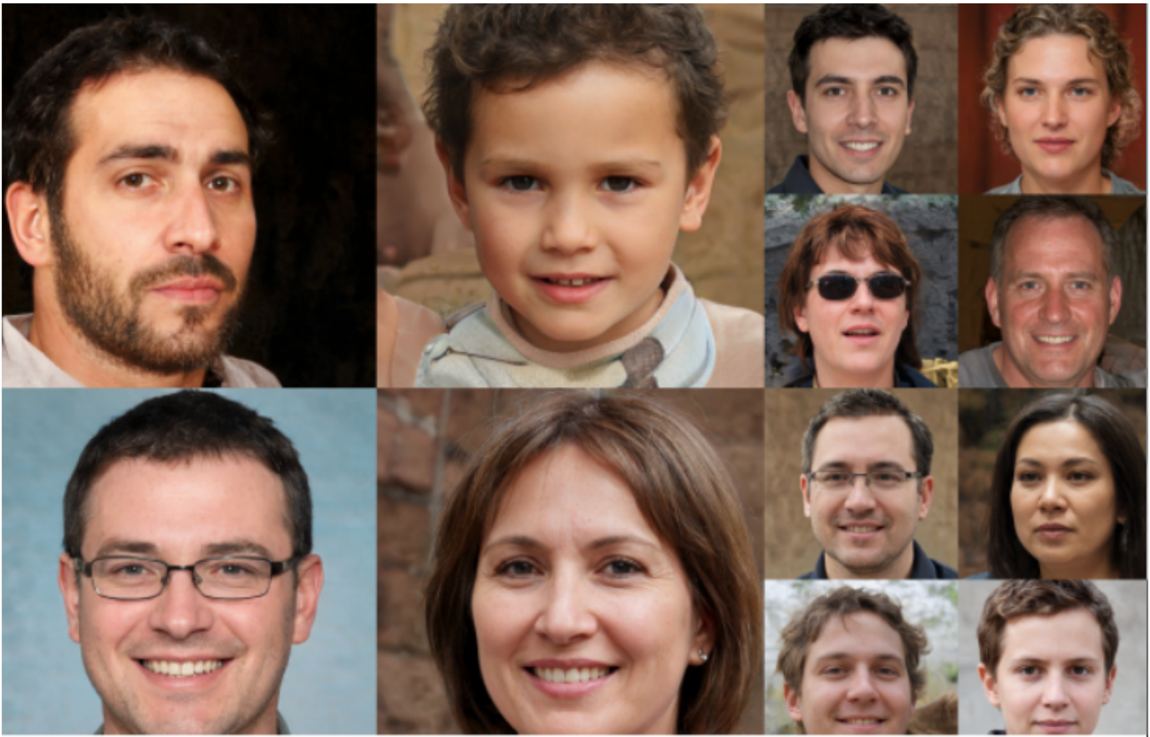

Machine Learning algorithms have achieved impressive milestones
Object detection (YOLO)
Text-to-Image Generation
prompt: “an armchair in the shape of an avocado”
Image Generation
Text generation (ChatGPT)

Slide 3
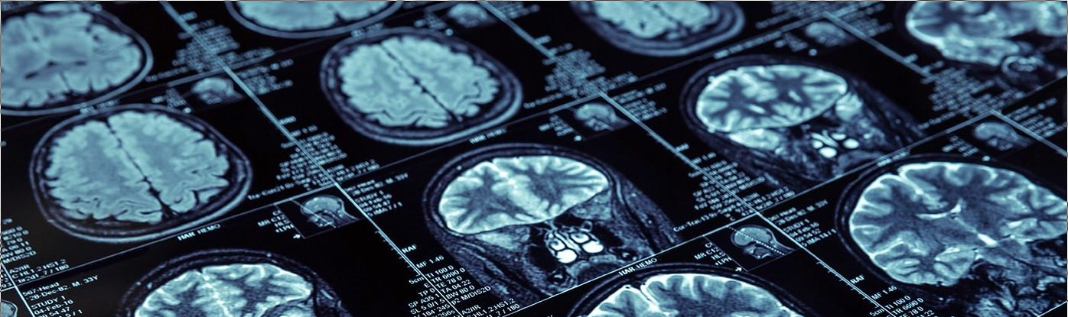

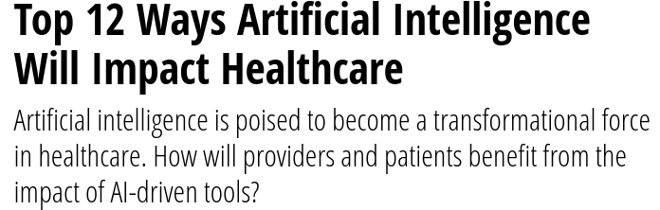

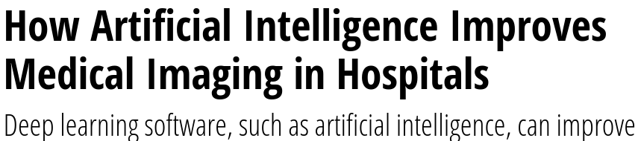
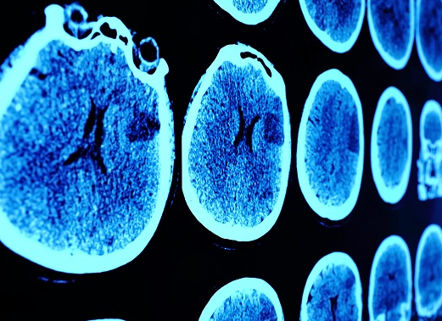
Machine Learning holds great promise for improving healthcare
Diagnose with unprecedented accuracy
Augment doctors

Slide 4
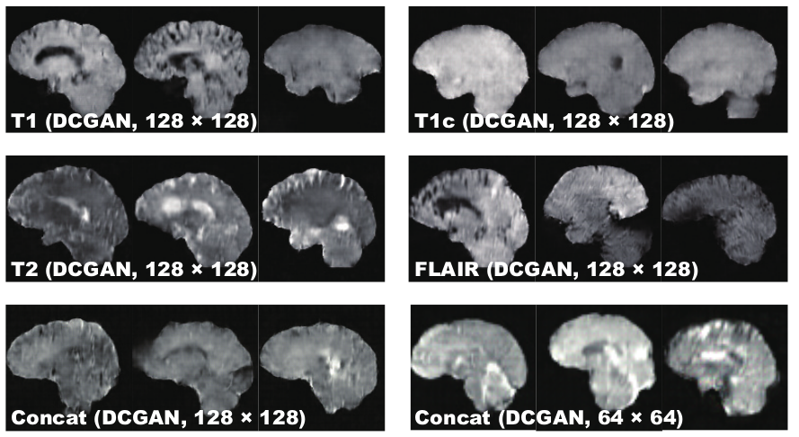
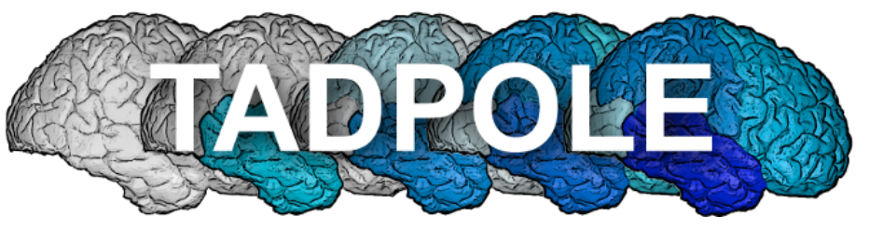
However, for many medical applications, these promises have not been fulfilled
Prediction of clinical variables not always working:
No algorithm (out of 62) could predict cognitive scores in Alzheimer’s disease (TADPOLE Challenge, Marinescu, 2021)
AI-Generated MRI images are crude, not high-resolution, mostly 2D
(Han, 2018)

Slide 5
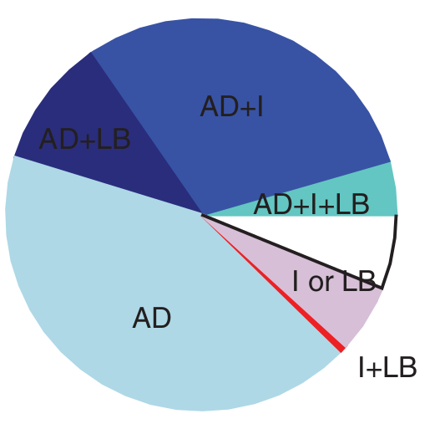
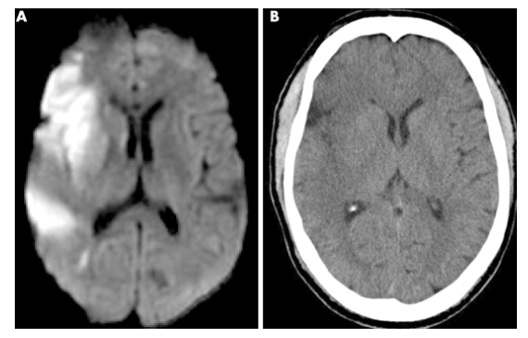
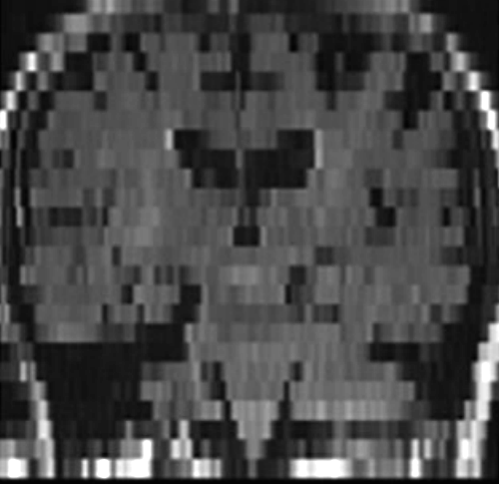
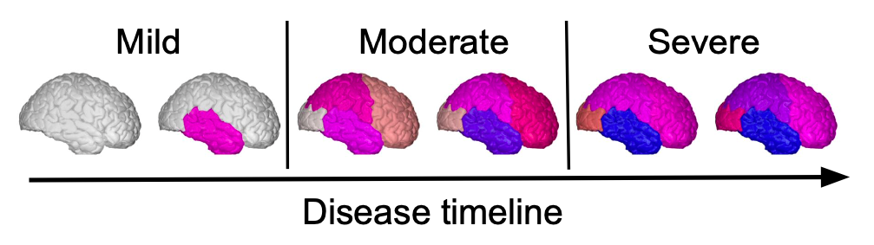
Why are Machine Learning models not working on medical applications?
Lack of good labels
Alzheimer’s diagnosis accuracy just 42%
Lack of good input data/signal
Limited contrast
Labels are categorical instead of continuous
Low-resolution

Slide 6
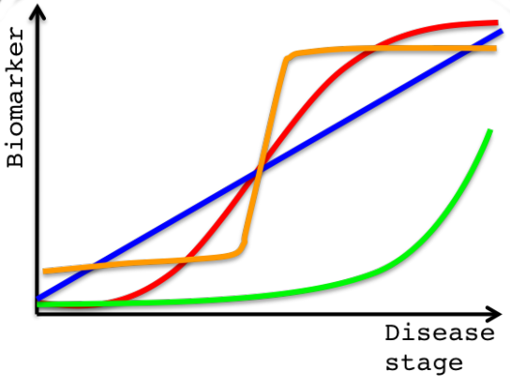
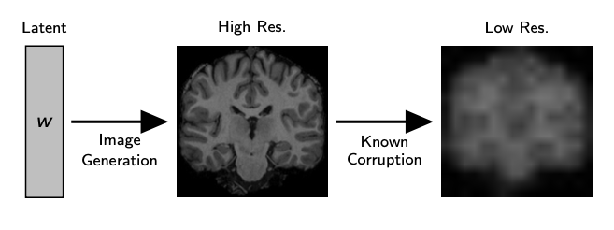
What can we do?
Lack of good labels
Solution: Unsupervised learning of patient trajectories = disease progression modelling
Lack of good input data/signal
Solution: Image Reconstruction with Deep Generative Models

Slide 7
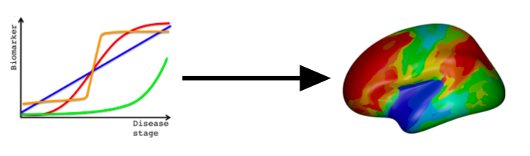
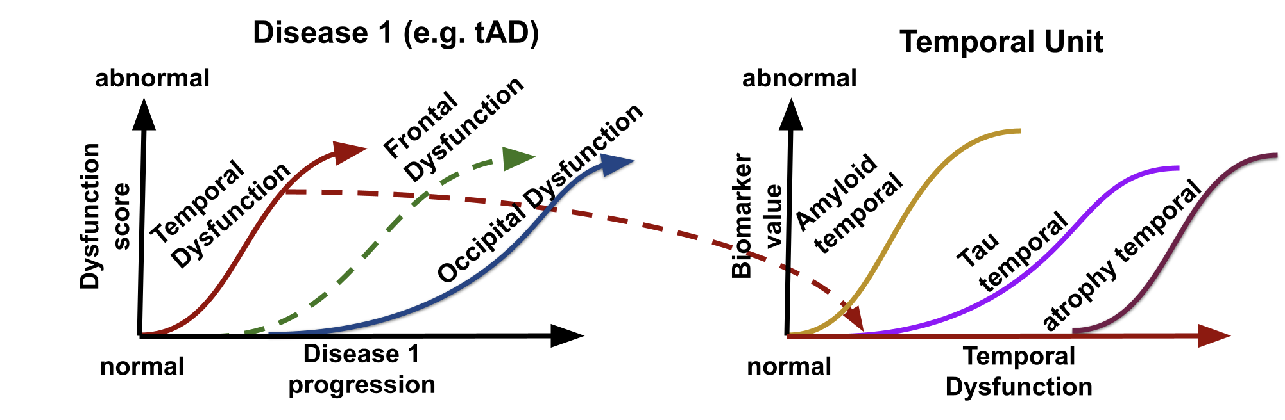
Outline
Disease progression modelling of Alzheimer’s disease
Image Reconstruction using Deep Generative Models
Joint Modelling of Multiple Neurodegenerative Diseases

Slide 8
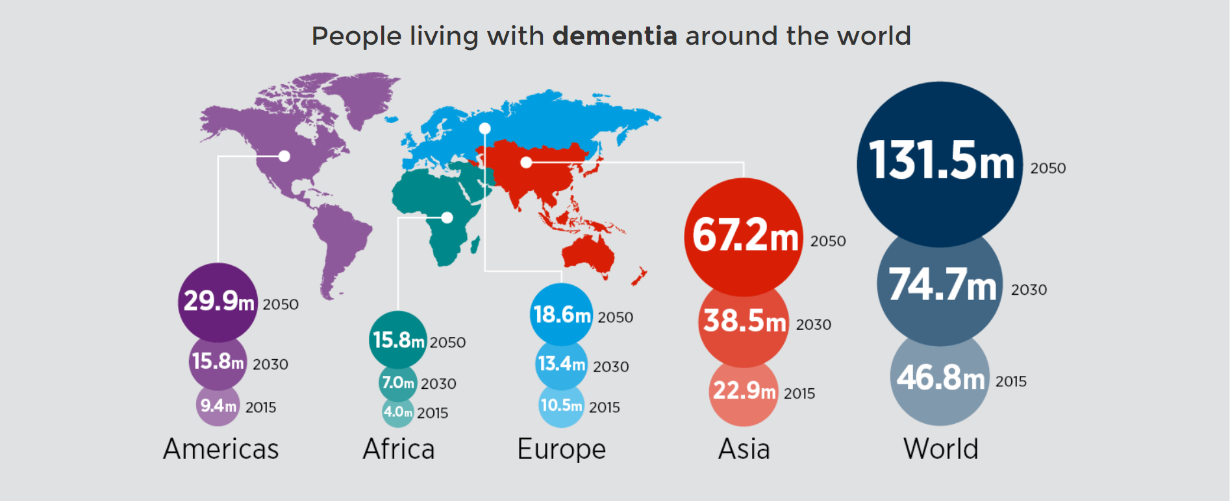
Alzheimer’s Disease is a Devastating Disease
46 million
people affected
No treatments available to stop or slow down cognitive decline
Why did clinical trials fail? Treatments were not administered early enough
How can we then identify subjects early in order to administer the treatments?
Disease progression model …

Slide 9
Building a Disease Progression Model

Slide 10
Building a Disease Progression Model

Slide 11
Building a Disease Progression Model

Slide 12
Building a Disease Progression Model

Slide 13
Building a Disease Progression Model

Slide 14
Building a Disease Progression Model

Slide 15
Building a Disease Progression Model

Slide 16
Building a Disease Progression Model

Slide 17
Building a Disease Progression Model

Slide 18
Building a Disease Progression Model

Slide 19
Building a Disease Progression Model
Can now build a population model

Slide 20
Building a Disease Progression Model
Can now build a population model
Early diagnosis

Slide 21
Building a Disease Progression Model
Can now build a population model
Early diagnosis

Slide 22
Building a Disease Progression Model
Previous models:
Jedynak, 2012
Fontejin, 2012
Donohue, 2014
Schiratii, 2017
Lorenzi, 2019
Can now build a population model
Early diagnosis
More accurate by analyzing all brain regions (ROIs)
Limitation: Require brain segmentation a-priori

Slide 23
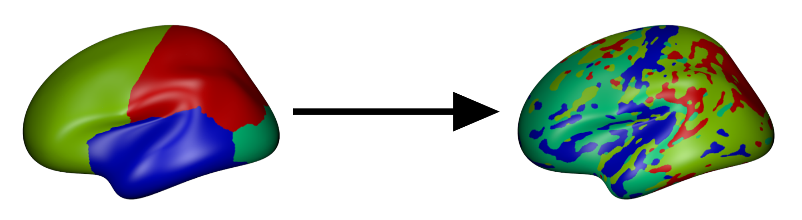
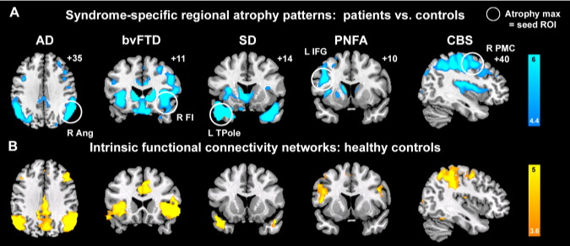
Aim: Build a disease progression model for vertexwise data
Aim: Move from segmentation-based analysis to vertexwise
Vertex = point on the brain surface
Why?
Atrophy correlates with functional networks, which are spatially disconnected (Seeley et al, 2009)
Atrophy = breakdown of neurons
Functional network = fMRI-derived connections between neurons
Better prediction and disease staging

Slide 24
Our model clusters vertices with similar trajectories of pathology

Slide 25
Our model clusters vertices with similar trajectories of pathology

Slide 26
Our model clusters vertices with similar trajectories of pathology

Slide 27
Our model clusters vertices with similar trajectories of pathology

Slide 28
Our model clusters vertices with similar trajectories of pathology

Slide 29
Our model clusters vertices with similar trajectories of pathology

Slide 30
Our model clusters vertices with similar trajectories of pathology
Contribution: Model can estimate pathology at each point on the brain surface

Slide 31
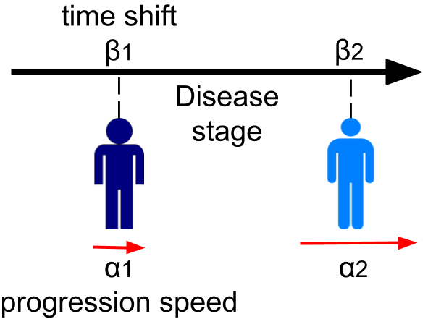
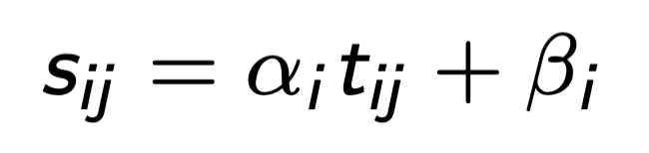
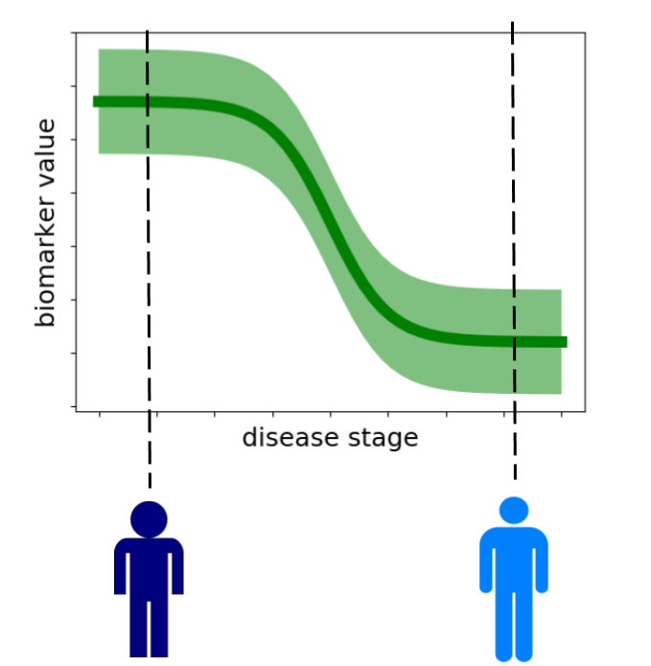
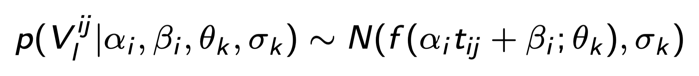
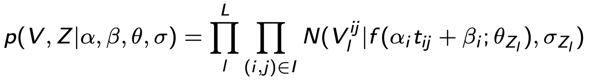
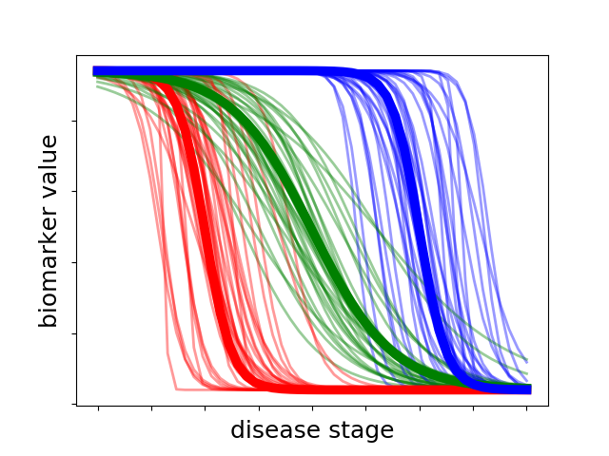
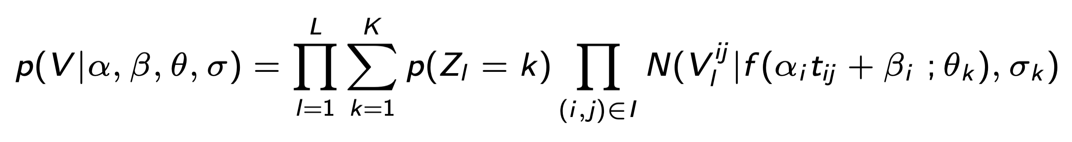
Building the model using a Bayesian framework
Model disease progression score for one subject i at hospital visit j:
Model trajectory of cortical thickness at one location l on the brain:
Extend to all locations and subjects:
Marginalize over the hidden variables Z_{l} (cluster assignments)

Slide 32
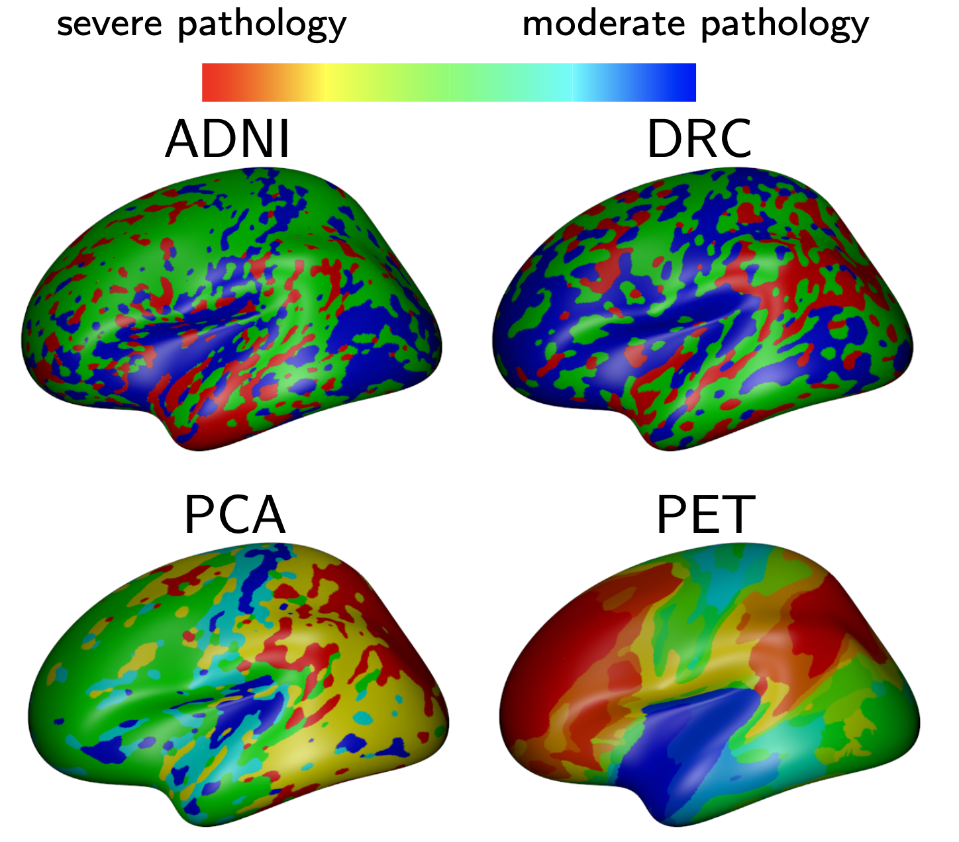
Our Model finds Plausible Atrophy Patterns on Four Datasets
Similar patterns of atrophy in independent Allzheimer’s MRI datasets (ADNI and DRC – Dementia Research Center UK)
Distinct patterns of atrophy in different diseases (Alzheimer’s vs PCA - Posterior Cortical Atrophy)
Marinescu et al, NeuroImage, 20019

Slide 33
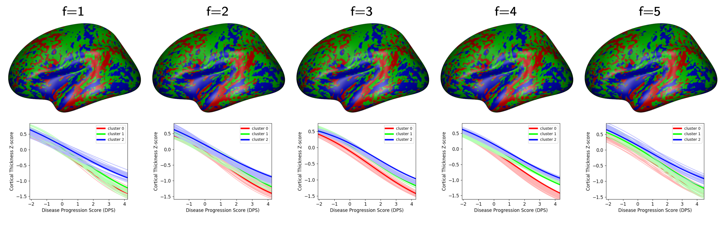
Validation – Model Robustly Estimates Atrophy Patterns
Method: Tested consistency of the spatial clustering using 10-fold CV (on ADNI)
Results: Good agreement in terms of spatial distribution (dice score 0.89)
Marinescu et al, NeuroImage, 2019

Slide 34
Disease Progression Modelling - Summary
We modelled the continuous progression of Alzheimer’s disease and related dementias
Used generative Bayesian model that does not require labels (unsupervised)
Plausible results on four datasets
However, such models require good quality data, to perform registration and extract disease markers
How can we do such modelling for scans with limited resolution and contrast?

Slide 35
Outline
Disease progression modelling of Alzheimer’s disease
Image Reconstruction using Deep Generative Models
Joint Modelling of Multiple Neurodegenerative Diseases

Slide 36
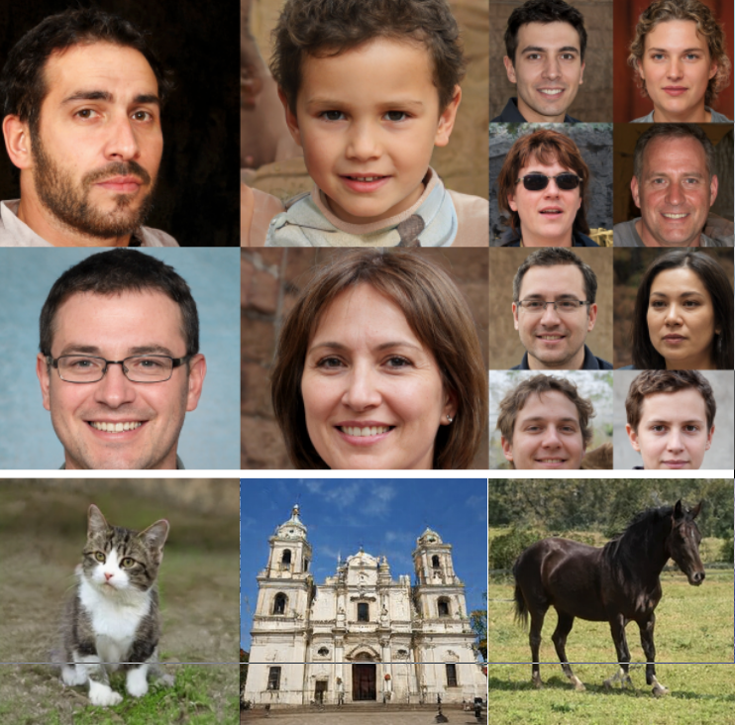
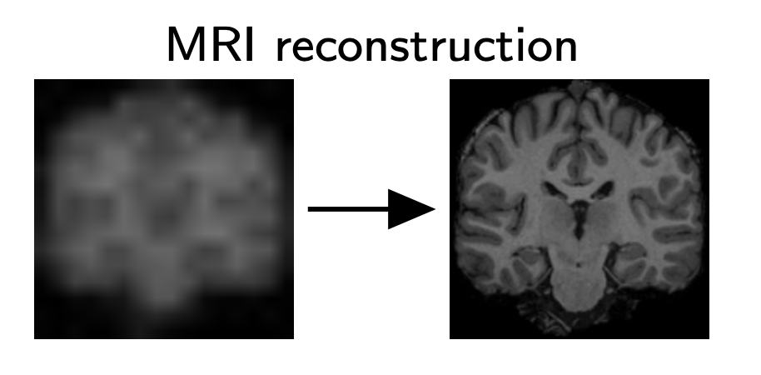
Aim: Image reconstruction using pre-trained generator models
Adapt state-of-the-art generative models (StyleGANs and diffusion models) for medical image super-resolution and reconstruction
Why pre-trained?
Current SOTA models take weeks-to-months to train on large clusters + large training costs ($)
StyleGAN2 (Karras et al, 2019)

Slide 37
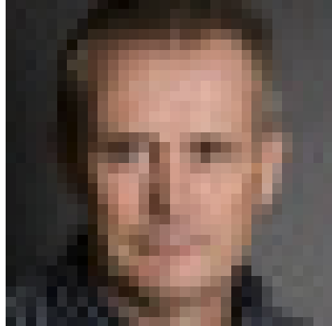
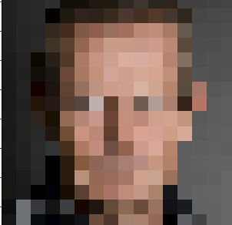

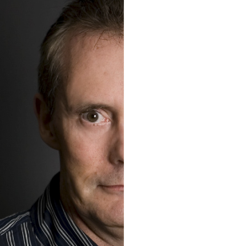
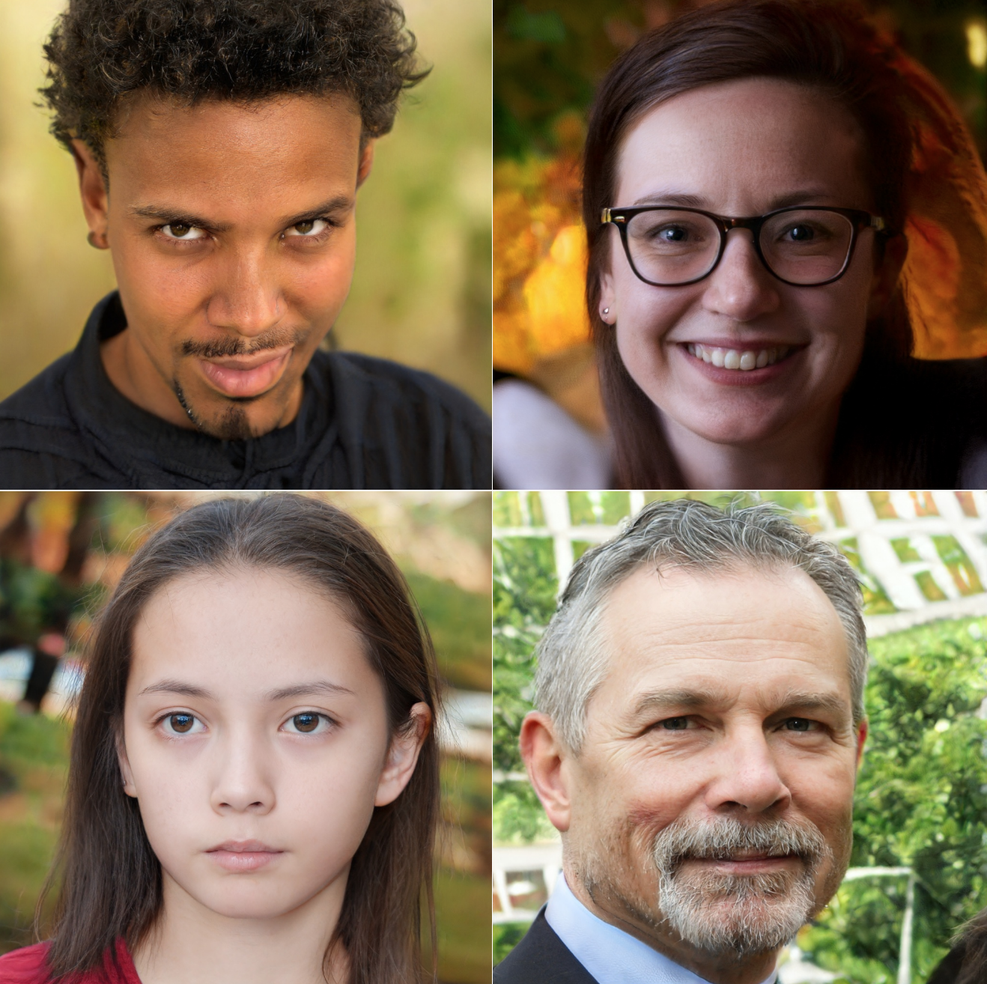
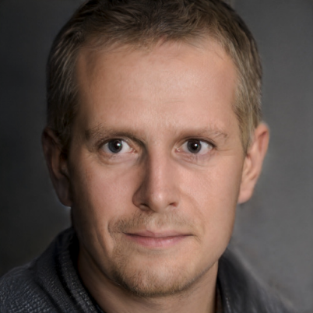
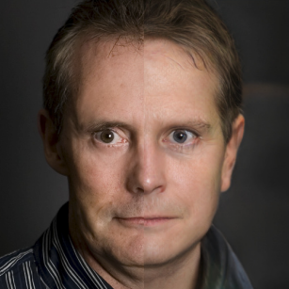
Aim:
Input
StyleGAN2
Super-resolution
Inpainting
Output
Does not need re-training for every corruption model
Notes:
Given a low-resolution input image, our method can perform super-resolution by leveraging pre-trained deep generative models.
We use pre-trained deep generative models to perform image reconstruction of images corrupted by any arbitrary, known corruption process. We demonstrate it on super-resolution and inpainting.
Since our method uses pre-trained deep generative models, it does not require re-training if the degradation level is changed, or if the blur kernel is changed.

Slide 38
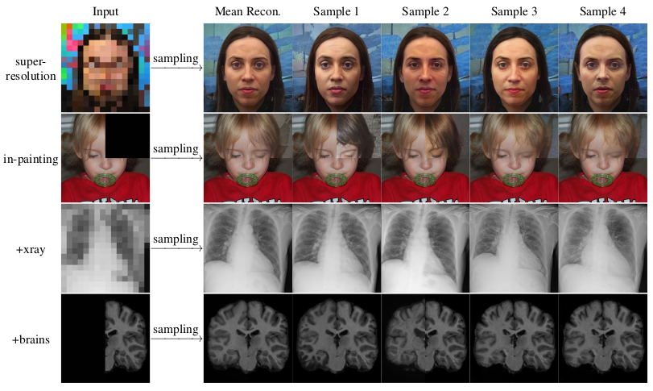
Sample multiple reconstructions
Notes:
Given an input image, our method can further sample multiple reconstructions by estimating an entire distribution of solutions. We are able to both sample solutions, as well as estimate the mean of the posterior.
We demonstrate our work not only on human faces, but also on two challenging medical datasets of (1) chest X-Ray images and (2) brain MRI images.

Slide 39
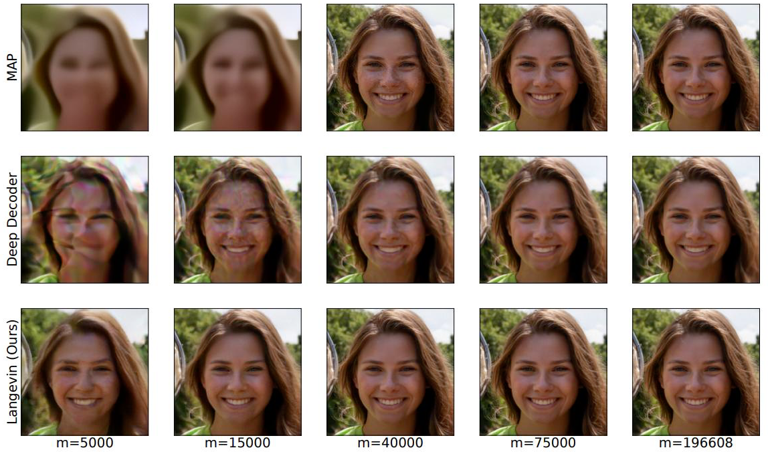
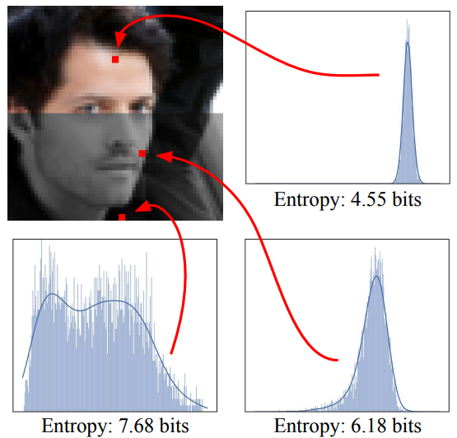
Previous methods
Langevin dynamics (Jalal et al, ICML, 2021)
Variational Inference (Whang et al, ICML, 2021)
Slow mixing, correlated samples
Only demonstrated for invertible flow models
Our contribution:
Formulate a Bayesian framework for inverse problems with DGMs
Allows optimizing distributional-losses instead of point-estimates
Demonstrate VI for GAN-based models (StyleGAN2/ADA)
Uses the learned latent space of the GAN
Notes:
Previous image reconstruc

Slide 40
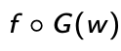
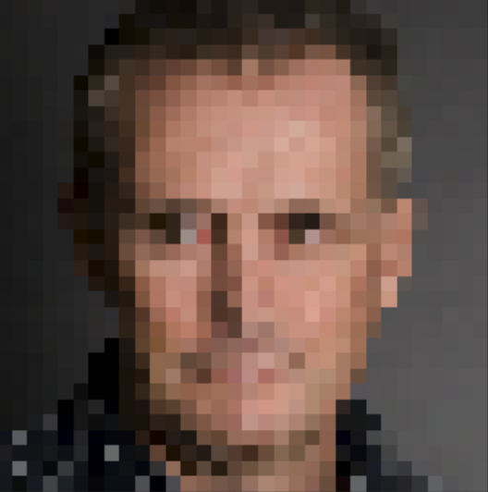
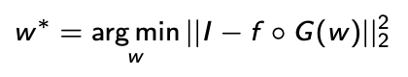
Our method
StyleGAN2
Input
w
G(w)
f
Image generation
Known corruption
Naïve reconstruction loss:
loss
However, this only optimizes a point-estimate instead of a distributional-loss.

Slide 41
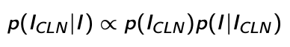
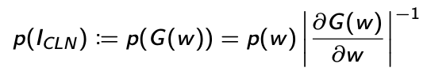
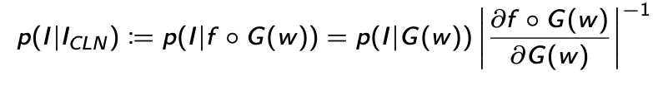
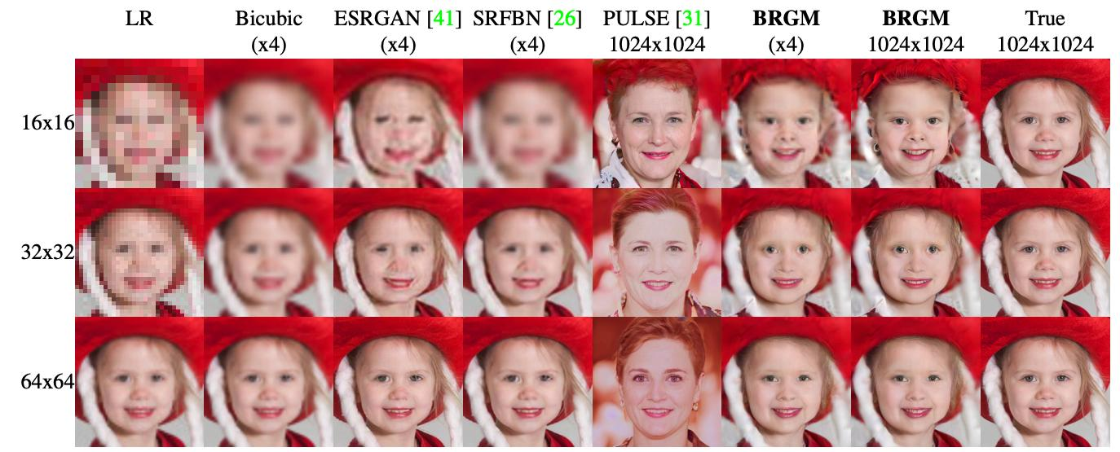
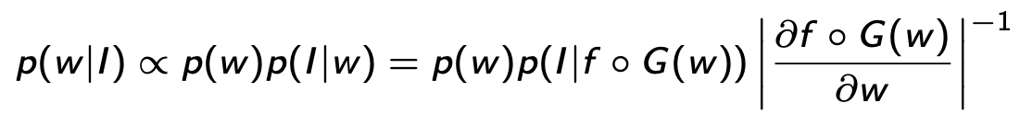
Our Bayesian approach
Likelihoods not possible with GAN models
Latent distribution
1.714
G
G
1.502
G
We re-cast the posterior as an optimization over w:
0.002
…
Notes:
The slide with: in the paper, we show how the prior and likelihood models are expressed, and the resulting optimization.

Slide 42
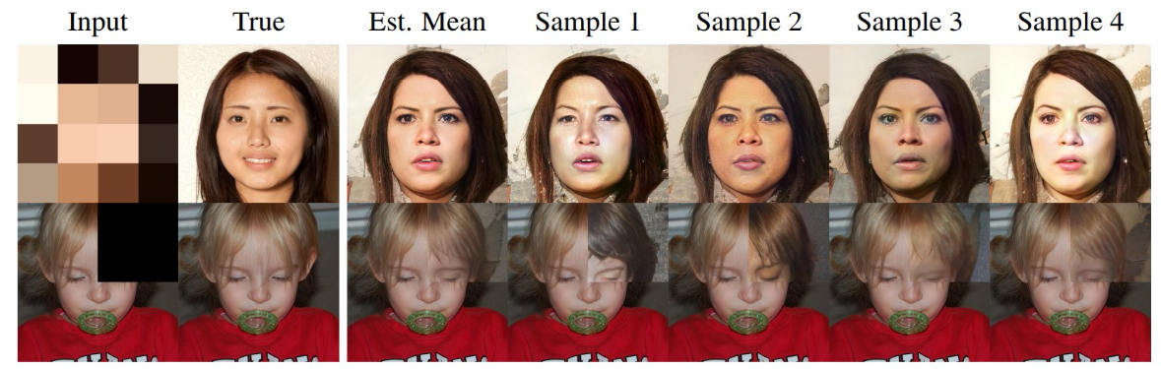
Sampling multiple reconstructions through Variational Inference
p(w|I)
G
We approximate the integral through Monte-Carlo sampling
G
q(w|θ)
Input
Mean
Sample 1
Sample 2
Sample 3
Sample 4

Slide 43
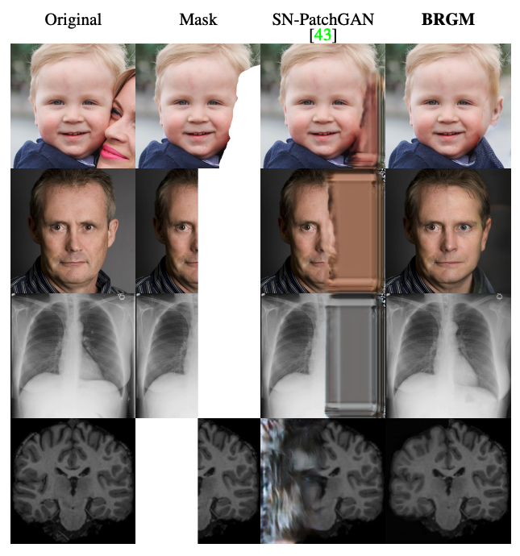



SOTA results on both SR and in-painting
Our method is most competitive in extremely ill-posed scenarios:
High degradation (Super-resolution at 16x16 input resolutions)
Large occlusion marks (in-painting)
Notes:
When compared to

